Slide 1
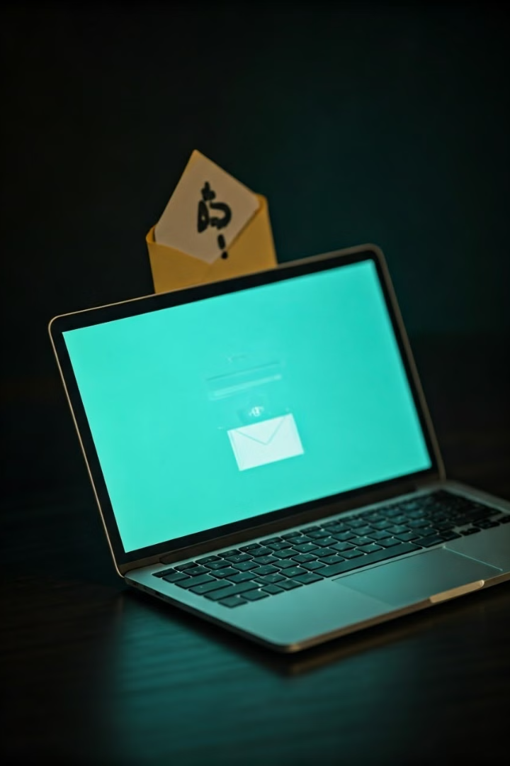
Phishing Attacks: Recognizing and Avoiding the Threat
Phishing attacks are a growing threat, with cybercriminals using deceptive tactics to steal sensitive information and gain unauthorized access. This presentation will equip you with the knowledge to identify and protect against these malicious attempts.

Slide 2

What is Phishing?
1
Deceptive Tactics
2
Personal and Financial Data
Phishing involves the use of fraudulent emails, messages, or websites to trick individuals into revealing sensitive information or performing actions that compromise their security.
Cybercriminals often target personal details, login credentials, credit card numbers, and other confidential information to facilitate identity theft and financial fraud.
3
Widespread Impact
Phishing attacks can have far-reaching consequences, affecting individuals, businesses, and even entire organizations if left unchecked.

Slide 3

Common Phishing Tactics
Fake Emails
Spoofed Websites
Cybercriminals often send fraudulent emails that appear to be from legitimate organizations, urging recipients to take immediate action or revealing sensitive information.
Phishers may create fake websites that closely mimic trusted online platforms, tricking users into entering their login credentials or other personal data.
Social Engineering
Malicious Links and Attachments
Manipulative tactics, such as impersonating authority figures or creating a sense of urgency, are used to coerce individuals into disclosing sensitive information.
Phishing emails may contain links or attachments designed to install malware or redirect users to compromised websites.

Slide 4
Identifying Phishing Emails
Sender's Identity
Greetings and Tone
Suspicious Links and Attachments
Closely examine the sender's email address, which may not match the organization it claims to represent.
Generic or impersonal greetings, as well as an urgent or threatening tone, are common in phishing emails.
Hover over links to verify their destination, and be cautious of unexpected or unsolicited attachments.

Slide 5
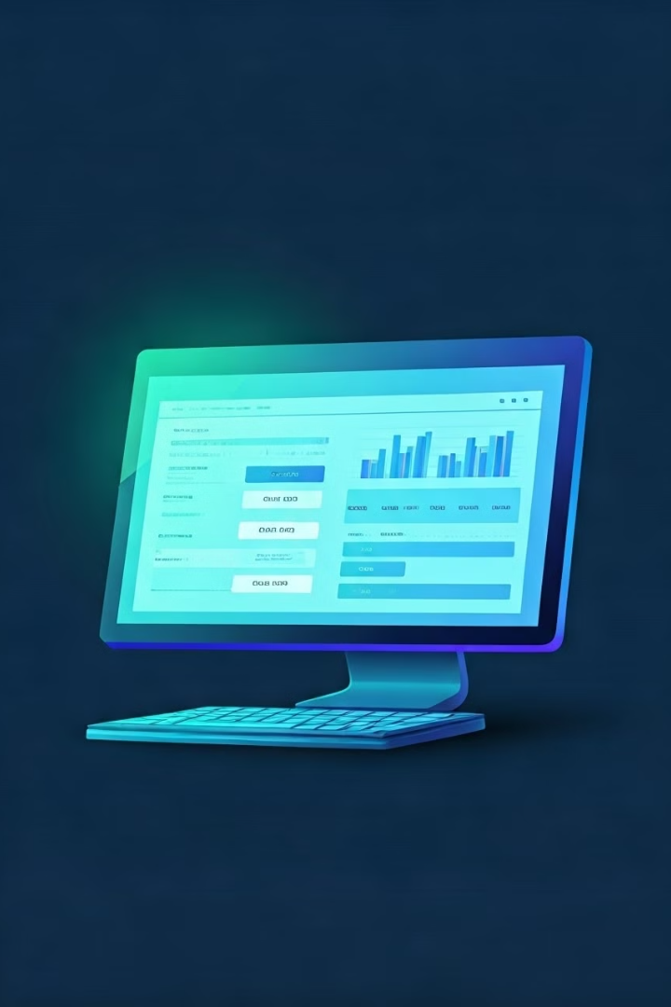



Spotting Fake Websites
Check the URL
Carefully inspect the website's URL for any subtle differences from the legitimate site.
Verify Security
Ensure the website uses HTTPS and has a valid SSL/TLS certificate to secure your connection.
Look for Inconsistencies
Be wary of websites with poor design, misspellings, or other inconsistencies that may indicate a phishing attempt.

Slide 6



Social Engineering Tricks
Impersonation
Cybercriminals may pretend to be authority figures, trusted contacts, or customer support to gain the victim's trust.
Sense of Urgency
Phishers often create a false sense of urgency to pressure victims into taking immediate action without verifying the request.
Psychological Manipulation
Phishers may exploit human emotions, such as fear, curiosity, or a desire to help, to persuade victims to disclose sensitive information.

Slide 7

Protecting Yourself from Phishing
1
Scrutinize Communications
Carefully examine all emails, messages, and website URLs for signs of phishing attempts.
2
Use Strong Passwords
Implement complex, unique passwords and enable two-factor authentication whenever possible.
3
Exercise Caution
Be wary of unsolicited requests for personal information and avoid clicking on suspicious links or attachments.

Slide 8
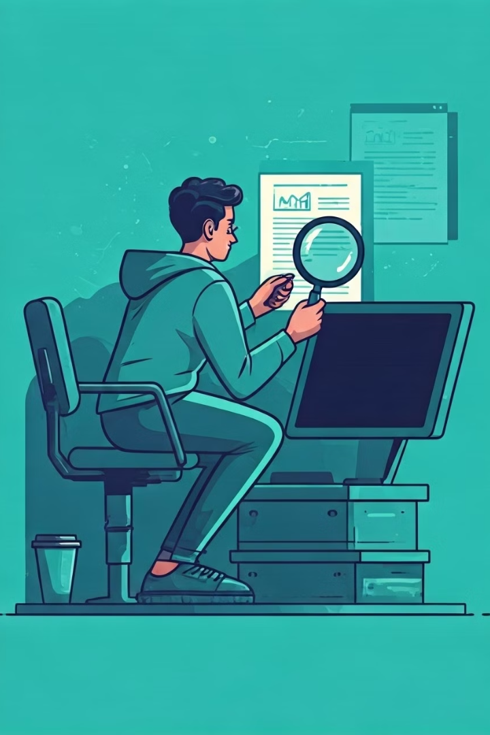
Best Practices for Handling Suspicious Messages
1
Verify the Source
2
Avoid Immediate Action
Contact the alleged sender through a known, trusted method to confirm the legitimacy of the request.
Don't feel pressured to respond or take action immediately, as this is a common tactic used by phishers.
3
Report Suspicious Activity
If you suspect a message is a phishing attempt, report it to the appropriate authorities or your organization's security team.

Slide 9
Reporting Phishing Attempts
Individual Reporting
Organizational Reporting
Law Enforcement
Report phishing emails to your email provider or the Anti-Phishing Working Group (APWG) to help identify and stop these attacks.
If you're part of an organization, report phishing attempts to your IT or security team to help protect the entire network.
In cases of identity theft or substantial financial loss, consider filing a report with the appropriate law enforcement agencies.

Slide 10

Staying Vigilant: Ongoing Phishing Prevention
Continuous Education
1
Stay informed about the latest phishing tactics and trends to improve your ability to recognize and avoid these threats.
2
Regular Security Checks
Periodically review your online accounts, credit reports, and device security to detect and address any potential compromise.
Proactive Monitoring
3
Utilize security software and monitoring tools to help detect and prevent phishing attempts in real-time.

